Slide 1

My Linear Relationships Interactive Notebook
Name:
Class:
Teacher:
Semester 2
Term 4
1

Slide 2

Interactive Notebooks!
Cover Page
Contents Page
Glossary
24/7/30
EQ
Questions
Notes
Summaries
Work page
Presentation!!!
Your book, your responsibility!

Slide 3

Quickwrite
What do you know about plotting points on a graph.
You have 2 minutes to write all you can remember
Notes:
Give them time to write what they know on the left hand side.
How you get the info off them is up to you, TPS, popcorn etc.

Slide 4
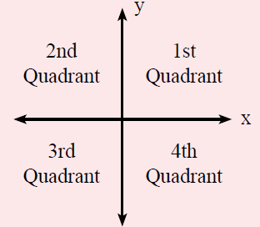

24
7
30
Topic: Linear Relationships
Date
EQ – How do I plot points on a Cartesian Plane?
What is the Cartesian Plane?
The Cartesian Plane has 4 quadrants, split up by the
___-axis (horizontal)
___-axis (vertical).
The center, where the axis meet, is called the origin.
$$Coordinates are \left(x ,y\right)$$

Slide 5
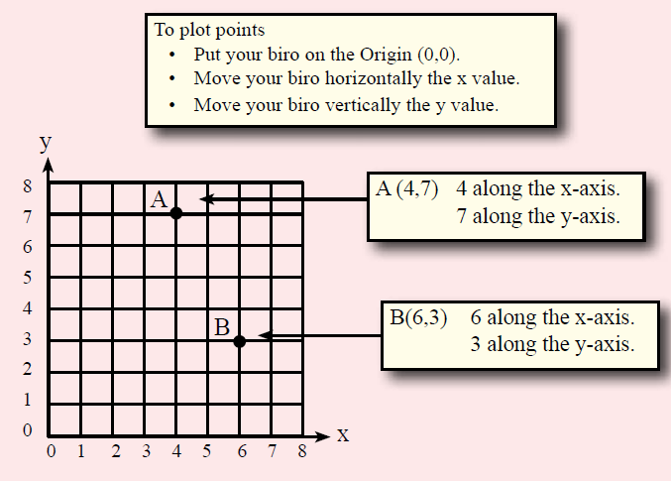
24
7
30
Topic: Linear Relationships
Date
EQ – How do I plot points on a Cartesian Plane?
How do you plot points on a Cartesian Plane?

Slide 6
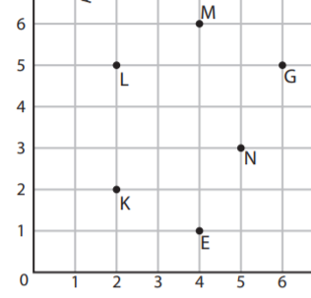
Your turn

Slide 7
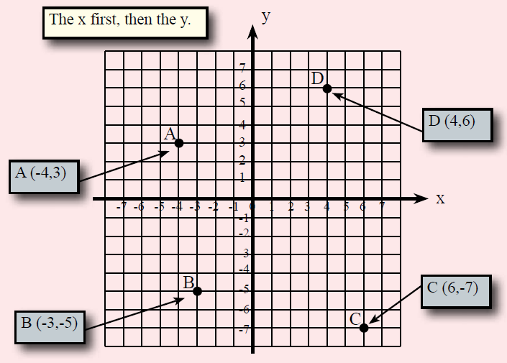
24
7
30
Topic: Linear Relationships
Date
EQ – How do I plot points on a Cartesian Plane?
How do you plot points on a Cartesian Plane?

Slide 8
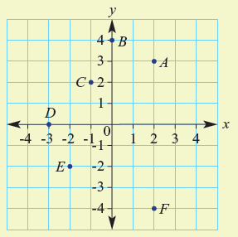

Let’s try one together
Write down the coordinates for A-F

Slide 9

Do you understand?
Notes:
Check for Understanding

Slide 10

Your Turn
WORKSHEETS
Left Hand Side

